Slide 1
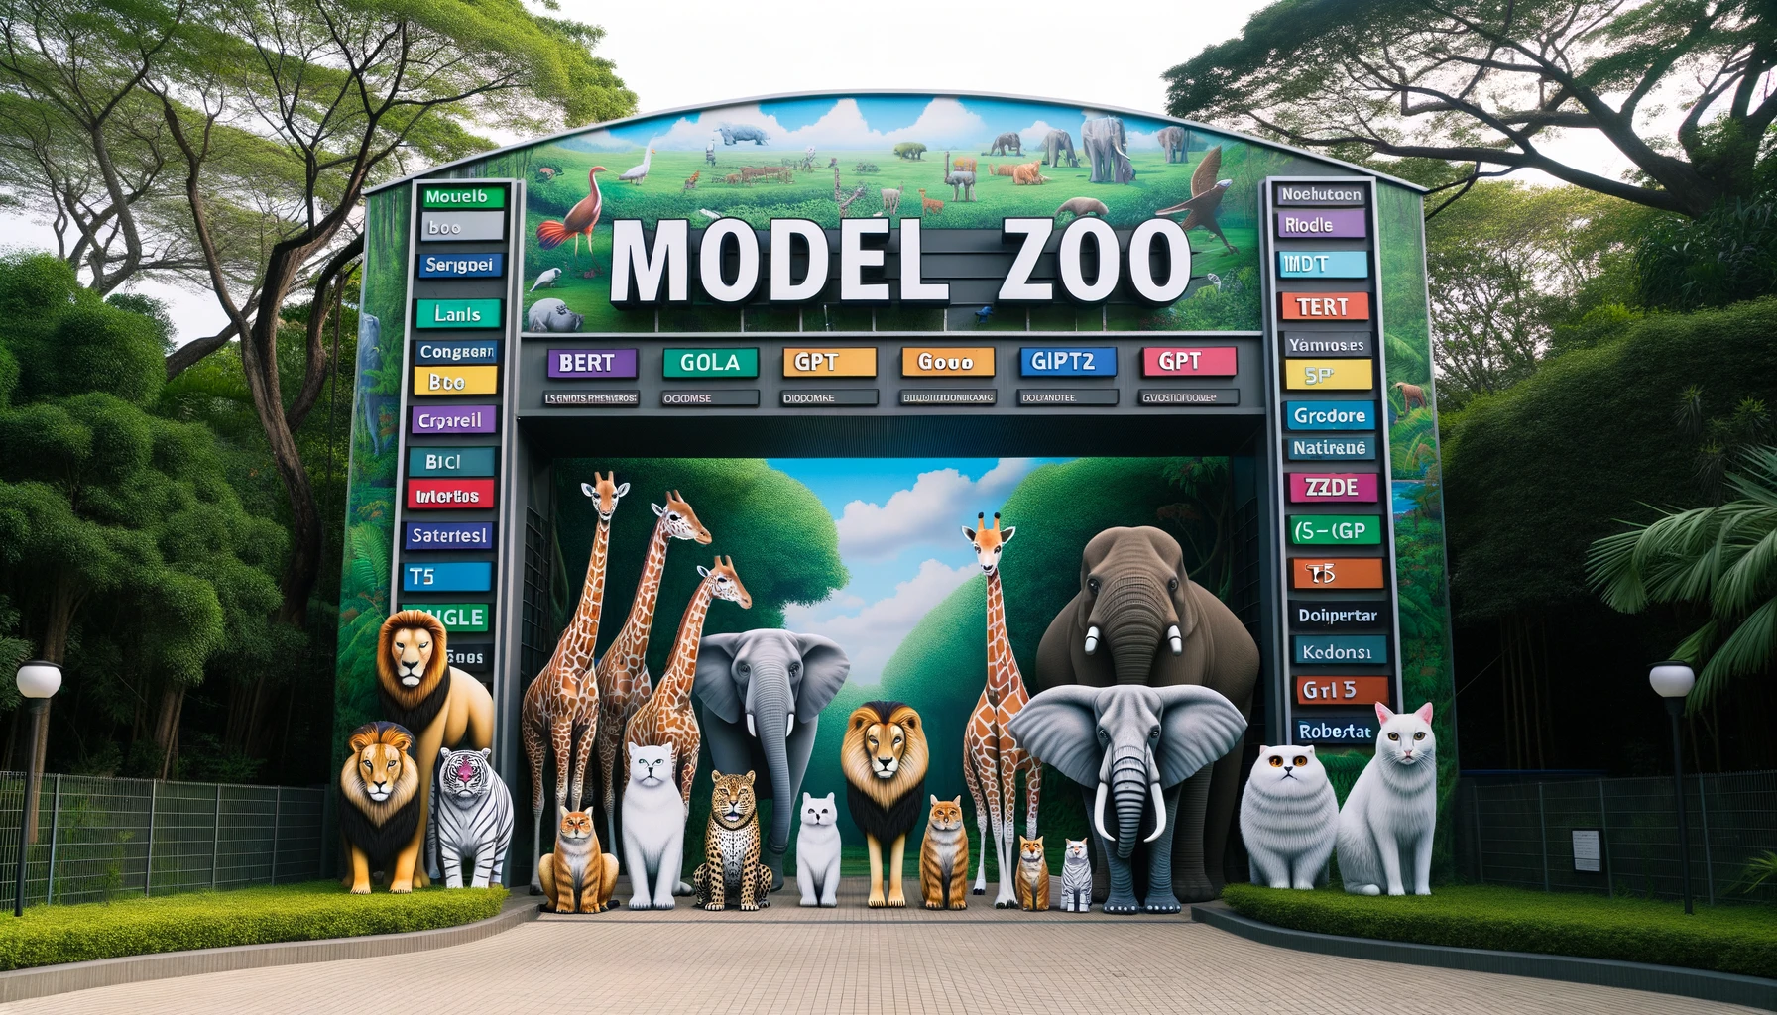

Integrative Master Project (Fall 2023)
Mid-Term Progress Presentations: Model Zoo - Language Transformers
Kaan Aydin, Sven Schnydrig
Notes:
Hello everybody and welcome to our presentation about model zoos for language transformers.

Slide 2
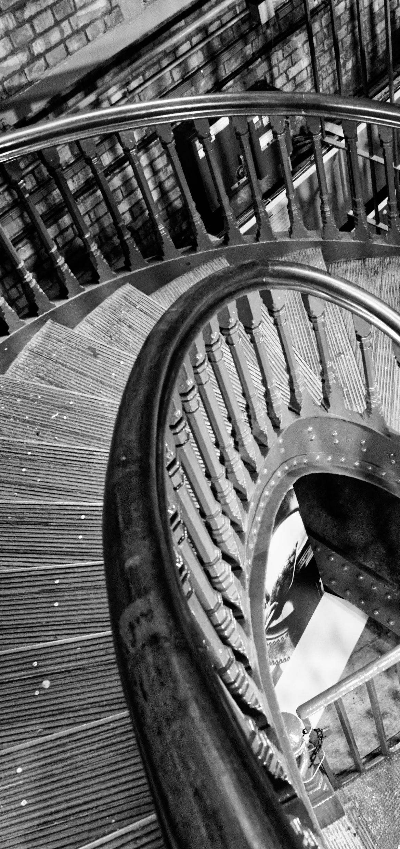






Introduction
Configuration Space
Latent Generating Factors
Trainings Protocol
Status & Next Steps
Agenda
Notes:
That’s the agenda for today. We’ll start with an introduction followed by configuration space, latent generating factors, training protocol and finally status and next steps.

Slide 3
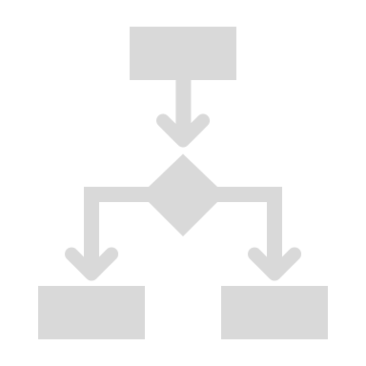



Introduction
Configuration Space
Latent Generating Factors
Trainings Protocol
Status & Next Steps
Agenda

Slide 4

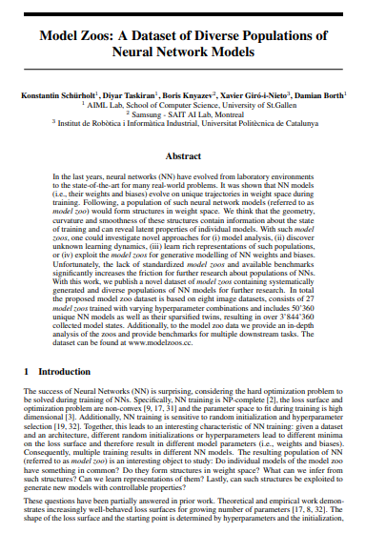
Context & Introduction
Introduction
NN models evolve on unique trajectories in weight space during training - depending on hyperparameters and weight initialization - leading to different model parameters (i.e., weights & biases) & minima on the loss surface
A population of NNs (or a model zoo) can form structures in weight space that contain information about the state of training and can reveal latent properties of individual models (e.g., accuracy)
With model zoos, we can investigate novel approaches for a variety of use cases, such as model analysis, discovering learning dynamics & generative modelling of NN models
The Blueprint paper^{[1]} used CNNs of varying sizes and datasets to generate model zoos – for our project, we will look at Language Transformers, focusing on BERT
Blueprint Paper^{[1]}
1. Schürholt, K., Taskiran, D., Knyazev, B., Giró-i-Nieto, X., & Borth, D. (2022). Model Zoos: A Dataset of Diverse Populations of Neural Network Models.
Notes:
I would like to start the presentation by giving you a bit of context for our project. As you might know neural networks evolve on unique trajectories in weight space during training, influenced by weight initialization and hyperparameters. This leads to different model parameters and minima on the loss surface.
When training a set of networks, called a "model zoo," structures form in the weight space, revealing properties of models, such as accuracy or training status.
By analysing those model zoos, we can explore various use cases, such as discovering learning dynamics, model analysis and even generative modelling of neural networks.
The blueprint paper of Damian Borth, Konstantin Schürholt and his colleagues used CNNs to generate model zoos and we will now work on language transformers, focusing on Bert.

Slide 5
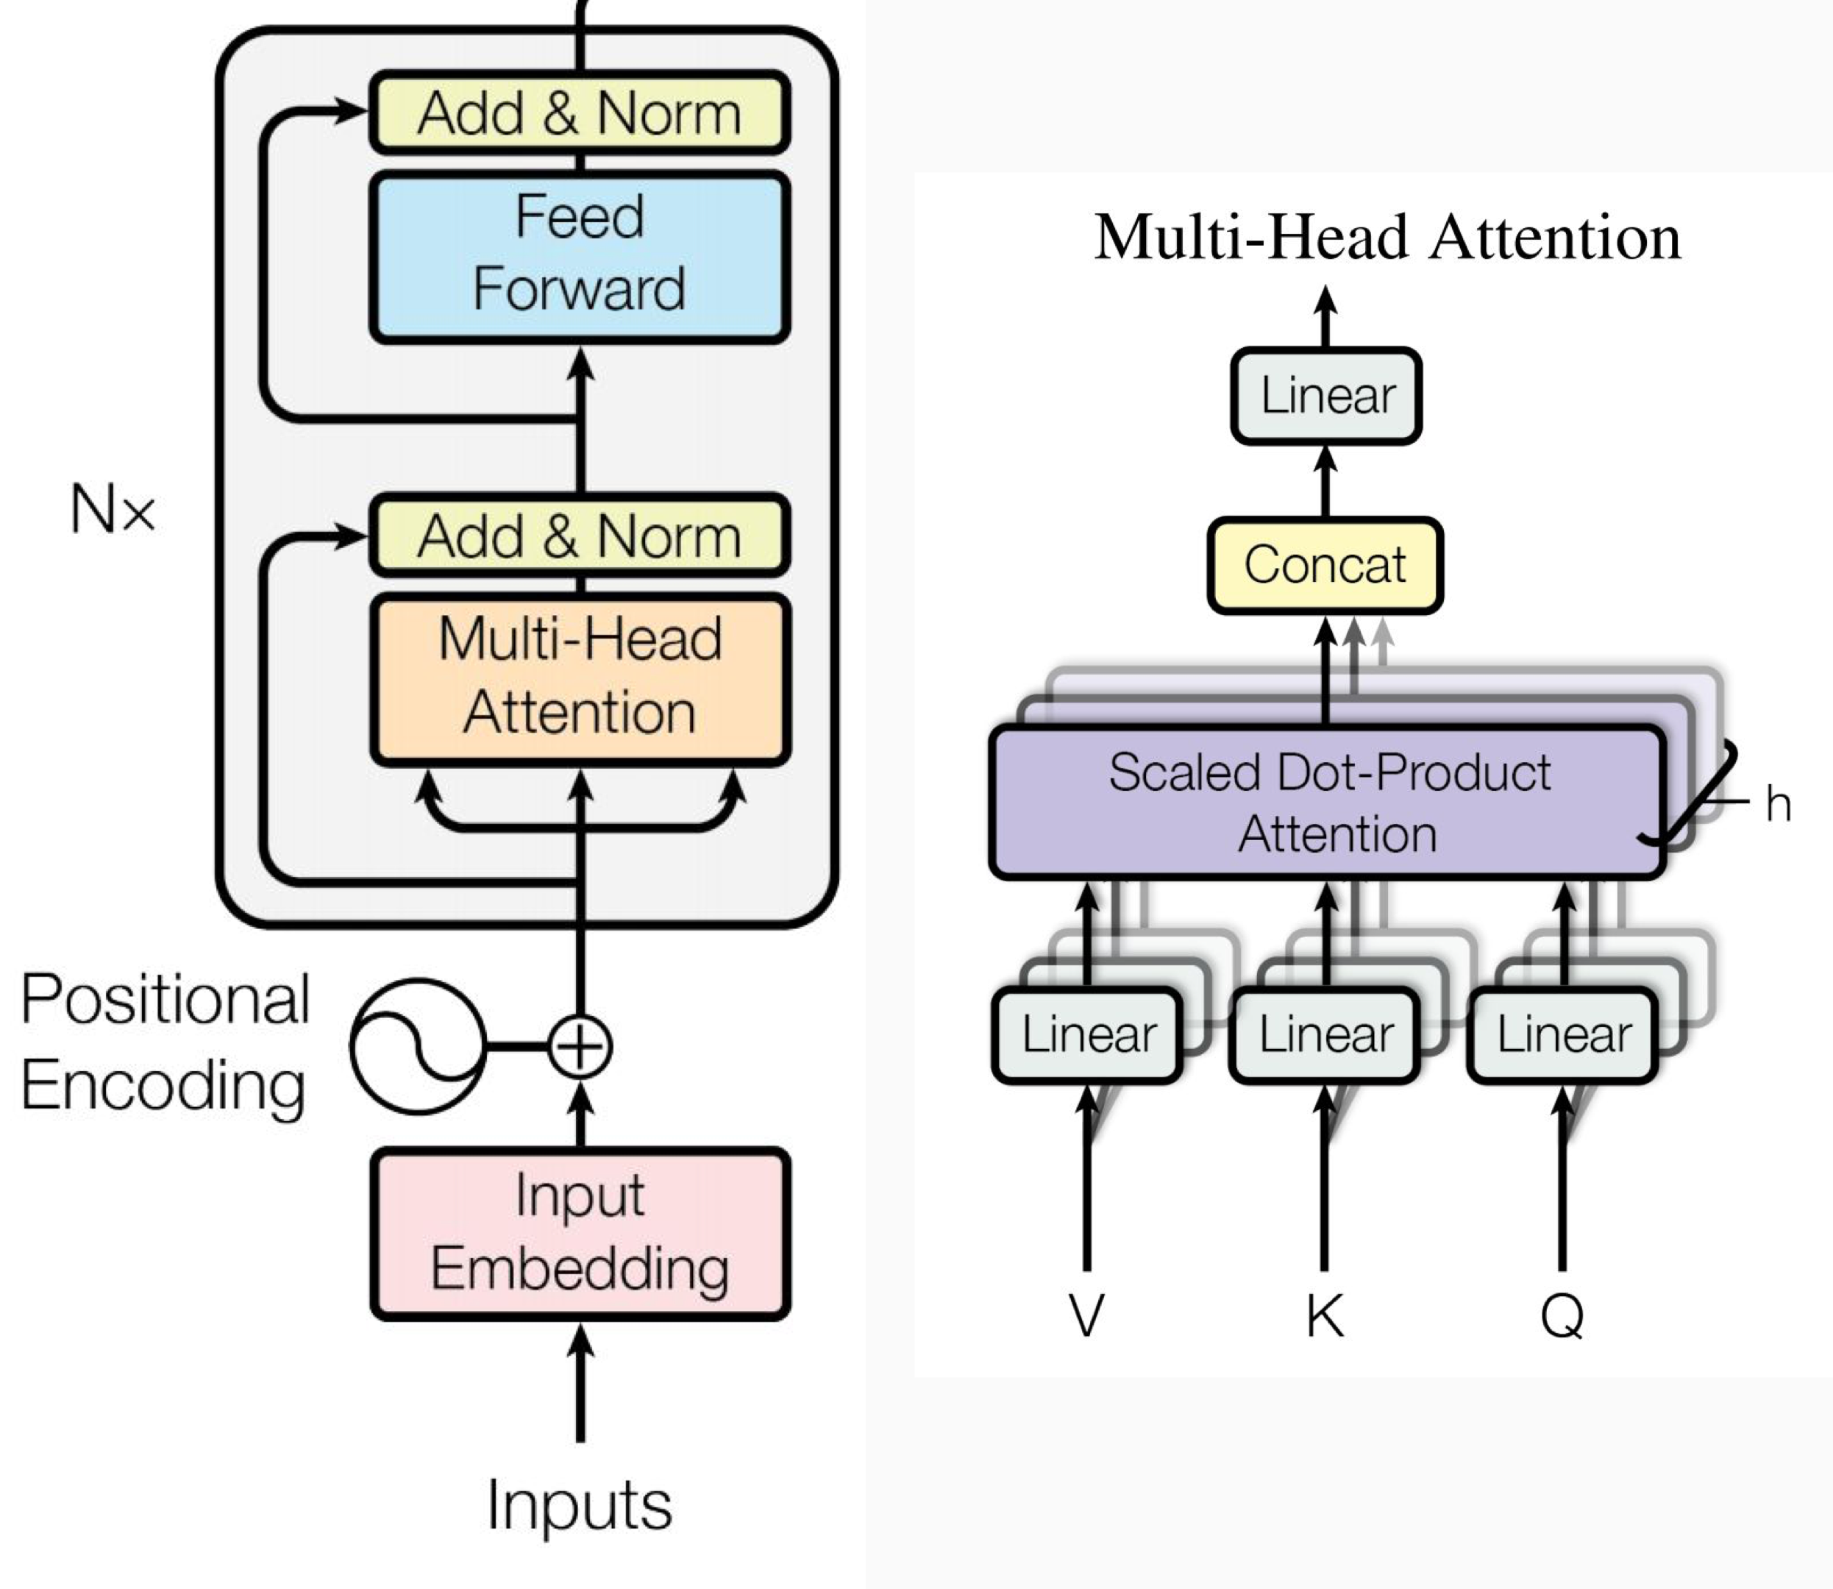
Unveiling the engine behind BERT’s success
Introduction
Introduced in 2019^{[1]}, BERT ignited significant advancements within the field of natural language processing
It employs a Transformer architecture^{[2]}, which uses self-attention mechanisms to enhance creation of contextualized embeddings
BERT only consists of encoder layers, thus processing text bi-directionally (i.e., from left and right)
Model Details
The base version of BERT consists of 12-encoder layers, each with 768 hidden units, 12 self-attention heads & 110M parameters
BERT was trained with data from Wikipedia (2.5B words) and BookCorpus (800M words)
Training Mechanism
BERT's success is attributed in part to its two-step training approach:
BERT learns language representations from text through pre-text tasks
Masked LM: This involves randomly masking out words from the input and having the model predict those words
Next Sentence Prediction: This involves predicting whether two given sentences are consecutive or not
BERT’s robust representations can be used for downstream tasks, e.g., Sentiment Classification, Question & Answering, Machine Translation, Named Entity Recog.
BERT variations
Many different variations of BERT were developed varying in size:
BERT-Large: 340M para., 24-layer, 1024-hidden, 16-heads
TinyBERT^{[3]}: 14.5M para., a smaller version distilled for maximum speed
DistillBert^{[4]}: 66M para., designed for speed by distilling knowledge from BERT
1. Devlin, J., Chang, M-W., Lee, K., & Toutanova, K. (2019). BERT: Pre-training of Deep Bidirectional Transformers for Language Understanding. 2. Vaswani, A., Shazeer, N., Parmar, N., Uszkoreit, J., Jones, L., Gomez, A. N., Kaiser, L., & Polosukhin, I. (2023). Attention Is All You Need. 3. Jiao, X., Yin, Y., Shang, L., Jiang, X., Chen, X., Li, L., Wang, F., & Liu, Q. (2020). TinyBERT: Distilling BERT for Natural Language Understanding. 4. Sanh, V., Debut, L., Chaumond, J., & Wolf, T. (2020). DistilBERT, a distilled version of BERT: smaller, faster, cheaper & lighter.
Notes:
So, let’s have a quick look at Bert. Bert was introduced in 2019 by Google and advanced the field of NLP. Bert’s innovation was to employ a transformer architecture which uses self-attention to enhance the creation of contextualized embeddings and most importantly, process the text bidirectionally, so from left AND right as opposed to previous models who mainly processed text sequentially.
The base version of Bert has 12 encoder layers and a total of 110 million parameters and was trained on 3.3 billion words from BookCorpus and Wikipedia.
BERT is trained in two steps: pretext tasks and downstream tasks training.
For pretext, first, we’ve the masked language modelling where random words are masked out and the model tries to predict those words. For example, you could have a sentence like “The man is drinking a glass of …” and then BERT would guess something like water or milk.
Then we’ve the next sentence prediction where Bert tries to predict whether two sentences are consecutive or not.
This pretraining creates a robust representation which can then be used for training on different downstream tasks.
Furthermore, there exist different versions of BERT in varying sizes.

Slide 6
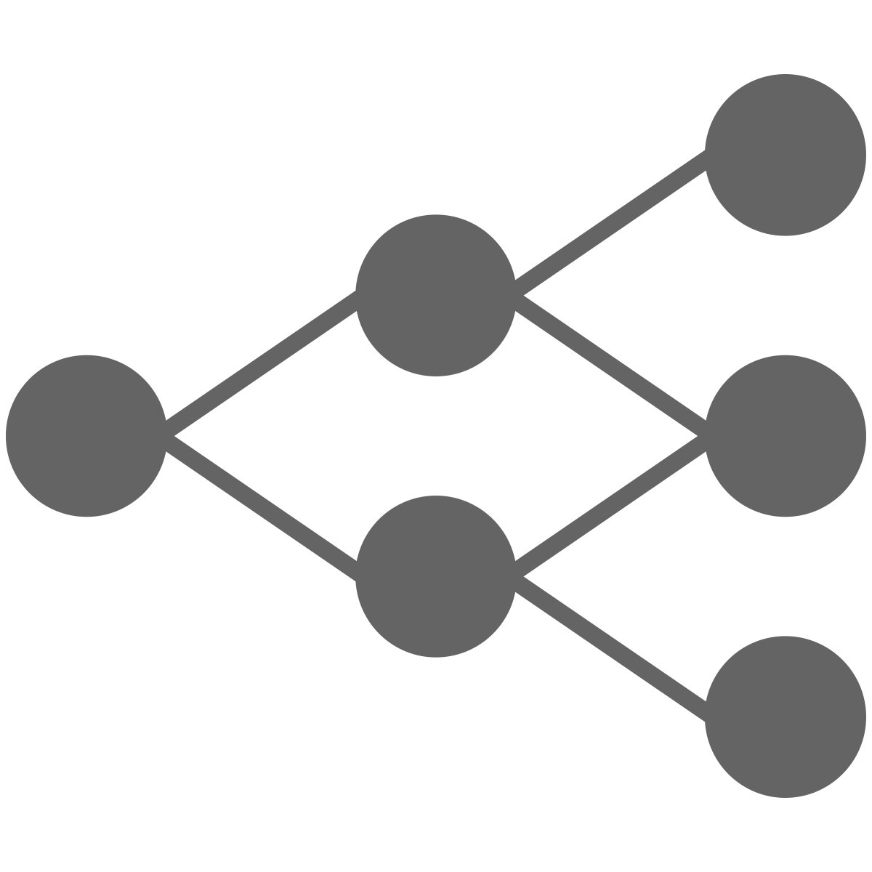

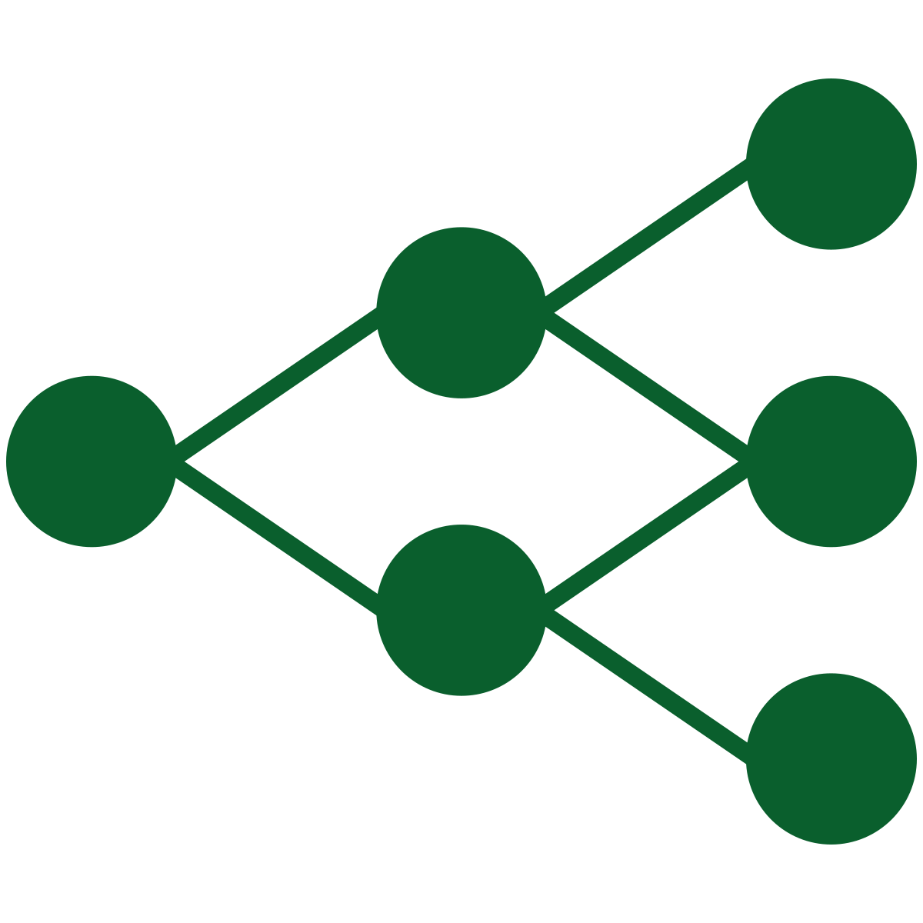

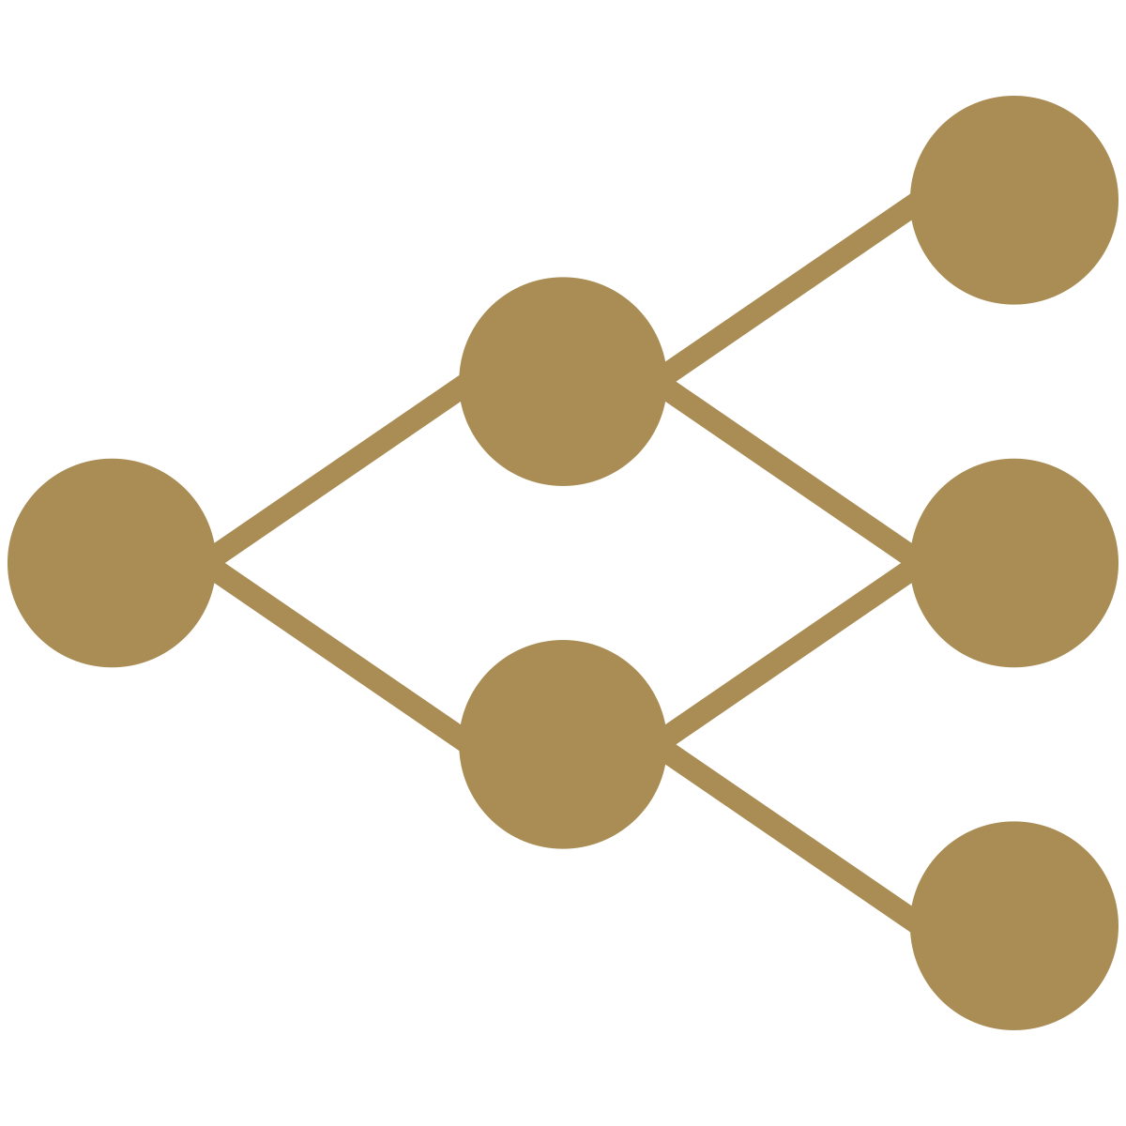


We move from a supervised-only to a two-step training process
Introduction
Transformers introduce an additional layer of intricacy in training (vs. CNNs) and require two training phases
CNN approach
(New) Transformer approach
Pre-Text Task
Downstream Task
ResNet
(empty)
Downstream task data
BERT
Pre-text task data
Pre-trained
BERTs
Downstream task data
Given the fundamental changes inherent to how transformers are trained, we need to redefine our training setup
Supervised learning
Pre-text task learning
Downstream task learning
Model Zoo of trained ResNets
Pre-trained BERTs
Model Zoo of task-specific BERTs
24 October 2023
Notes:
So, as you’ve seen before, the transformer architecture, adds an additional layer of complexity as we move from a supervised-only to a two-step training process.
With the CNN approach the training was relatively straightforward and you would train a model with supervised learning on image classification to create your diverse model zoo.
With transformers we’ve a completely new approach. Initially, we use pretext tasks like masked language modelling and next-sentence prediction to produce a diverse zoo of pretrained Berts.
We then take those pretrained Bert and undergo a second round of training on downstream tasks, such as sentiment classification and question answering to create a diverse zoo of task specific BERTs.
Considering this fundamental shift in how transformers are trained, we must reevaluate our training setup and think along three dimensions:

Slide 7

Introduction
Configuration Space
How does our configuration space look like?
How do we ensure model diversity given our resources?
…
Generating Factors
What datasets do we use for the pre-text and downstream task?
For which hyperparameters do we configure ranges?
…
We need to rethink along three area, addressing relevant questions for each
Training Protocol
For how many epochs do we train each model training trajectory?
Are the splits for train, validation and test kept consistent?
…
Notes:
Considering this fundamental shift in how transformers are trained, we must reevaluate our training setup and think along three dimensions:
First there is the Configuration space
Then the Generating factors
and finally, the training protocol
I’ll now pass the word to Kaan who will tell you more about those areas in detail.

Slide 8

Introduction
Configuration Space
Latent Generating Factors
Trainings Protocol
Status & Next Steps
Agenda
Notes:
Before even getting started with our training pipeline, we first had to think conceptually about our configuration space and answer the questions:
how do we generate model diversity, and
which configuration balances diversity and computational resources
This was an important conceptual step for us because compared to Vision Transformers, Language Transformers take significantly longer to train, adding an additional complexity.
So, started by mapping our configuration space…

Slide 9



We outline our configuration space over two training steps in four sub-components
Configuration Space
BERT (base, pre-trained)
Pre-Text Task
BERT (base, empty)
1
Model selection
TinyBERT (empty)
…
2
Training approach
Pre-Training from scratch
Continued pre-training
Down-stream Task
3
Weights in TF blocks
Unfreeze weights of TF blocks
Freeze weights of TF blocks
Sentiment Analysis
4
Classification Head
Question Answering
…
Notes:
… over two trainings steps and then in further into four sub-components.
For Model Selection, we need to choose a model as our basis, for instance an empty or pre-trained BERT, or smaller models like TinyBERT
For Training Approach, we evaluate whether we pre-train from scratch or do continued pre-training
The third points refer to the question whether we unfreeze or freeze the weights in the transformer blocks
Then lastly, we look at which downstream tasks we will be focusing on, for instance sentiment analysis or question answering

Slide 10
We evaluated multiple options to determine the best configuration going forward
Configuration Space
Pre-training BERT from scratch is expensive (~800 days with current resources / model) vs. continued pre-training
Not exhaustive
1
2
3
4
Model selection
Training approach
Weights in TF blocks
Classification Head
Computational Requirements
Training the classification head is rather “cheap” compared to pre-training
BERT-base (empty)
PT from scratch
Unfrozen weights
Sentiment
Very high
…
…
…
…
BERT-base (pre-trained)
Continued PT
Unfrozen weights
Sentiment
Medium
By unfreezing weights in the TF blocks, we can generate more diversity in the BERT layers
Q&A
Frozen weights
Sentiment
Q&A
…
…
…
We focus on continued pre-training and 2 DS tasks to balance model diversity & resource availability
TinyBERT (empty)
PT from scratch
Unfrozen weights
Q&A
Very high
…
…
…
…
24 October 2023
Notes:
We then mapped out all configurations to determine the best one going forward
When looking at Pre-Text Task, we determined that pre-training BERT from scratch is computationally very expensive vs. continued pre-training.
To give you a number on this, we estimate that pre-training BERT with the standard setup, it would take us approx. 800 days to do so with our available resources
Looking at the Downstream Task, training the classification head – even when unfreezing the TF blocks – computationally rather “cheap”
Also, the upside of unfreezing the TF layers, we can generate even more diverse BERT backbones, increasing the diversity of our model zoo
Ultimately, we decided to focus on continued pre-training and two DS tasks on Sentiment Classification and Question & Answering

Slide 11
Introduction
Configuration Space
Latent Generating Factors
Trainings Protocol
Status & Next Steps
Agenda
Notes:
Now let’s look at the latent generating factors

Slide 12



A model zoo’s generating factors is defined by three components
Latent Generating Factors
We need to define the generating factors for the:
Pre-text task
Downstream task
Architecture
Dataset
Hyperparameters
24 October 2023
Notes:
A model zoo’s latent generating factors are defined by three components – architecture, dataset & hyperparameters, which we need to define for our pre-text task & downstream, respectively

Slide 13
Architecture for the Pre-Text and Downstream Task
Latent Generating Factors
Pre-Text Task
Downstream Task
BERT (base) consists of 12 Transformer encoders that are stacked on top of each other, returning a 768-dimensional embedding as the final layer (i.e., the [CLS] token’s output)
The embedding layer (lowest layer) contains three types of embeddings which are added and passed as input to the first encoder stack
In typical BERT classification, the [CLS] token's output is directly (without any hidden layers) used for classification due to its comprehensive representation of the input
However, we introduce 1 additional (hidden) layers in the classification head to generate more weights which can be used for further processing (e.g., model analysis)
Word embed + Pos embed + Type embed
Transformer blocks
Output layer
Input layer
Hidden layer
Output layer
12x
Add & Norm
FFN
Add & Norm
MHSA
dimensions
Batch Size x 512 x 768
768
dimensions
768
256
1
BERT architecture
MLP classification head
Notes:
As mentioned before, for the pre-text task, we will take the BERT model as our basis
After processing the text in forms of embeddings, the BERT returns a 768-dimensional output layer
For the downstream task, we use an MLP classification head
Typically, the output layer from BERT is used directly for the classification, however we add an additional hidden layer to generate more weights, which can be used for further processing

Slide 14
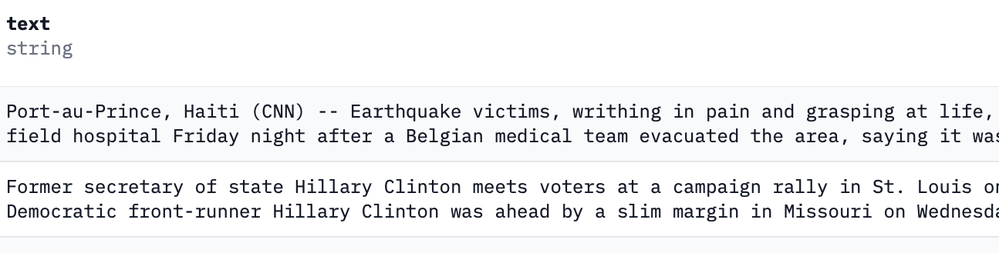
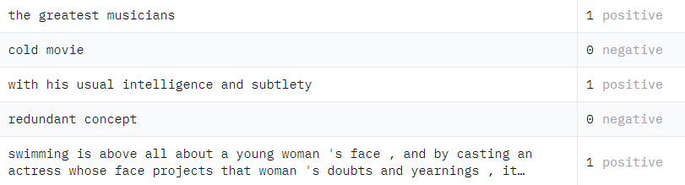
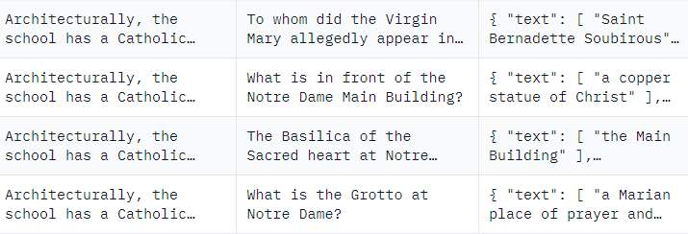
Datasets for the Pre-Text and Downstream Task
Latent Generating Factors
Pre-Text Task
Downstream Task
We decided to use the OpenWebText dataset^{[1]} for the continued pretraining
Openwebtext is an open-source replication of the WebText dataset from OpenAI that was used to train GPT-2
Sentiment Analysis
We will use the Stanford Sentiment Treebank (SST-2)^{[2]}, which contains ~70k observations
Evaluation metric: accuracy
Question Answering
We will use the Stanford Question Answering Dataset (SQuAD) dataset^{[3]} which contains over 100,000 Q&A pairs
Evaluation metric: F1 score
OpenWebText dataset
SST-2
SQuAD
1. Gokaslan, A., Cohen, V., Ellie, P., & Tellex, S. (2019). Openwebtext corpus. 2. Socher, R., Perelygin, A., Wu, J., Chuang, J., Manning, C., Ng, A., & Potts, C. (2013). Recursive Deep Models for Semantic Compositionality Over a Sentiment Treebank. 3. Rajpurkar, P., Zhang, J., Lopyrev, K., & Liang, P. (2016). SQuAD: 100,000+ questions for Machine Comprehension of Text.
Notes:
For the Pre-Text, we use the OpenWebText dataset, which is an open-source replication of the data that was used to train GPT-2
For the Downstream task, we use the SST-2 dataset for sentiment analysis and the SQuAD dataset for Question Answering – both of which are commonly used datasets
As evaluation, we will use accuracy and the F1 score respectively

Slide 15
Hyperparameters for the Pre-Text and Downstream Task
Latent Generating Factors
Pre-Text Task
Downstream Task
Learning Rate
1e-04, 3e-04, 5e-04
2e-05, 3e-05, 5e-05
Weight Decay
0.01, 0.001
0.1, 0,01
Number of Epochs
Constantly for 10 epochs
Constantly for 5 epochs
Batch Size
Depending on HW (16 or 32)
Optimizer
Adam
AdamW
Dropout Rate
0.1
0.1
Learning Rate Scheduler
No warmup steps to keep learning rate constant
Learning Rate Decay
No learning rate decay to keep learning rate constant
Activation Function
GeLU
ReLU / SoftMax
Masking Fraction
15% (same as original BERT)
not applicable
Max Sequence Len
Keep fixed at 512
Initialization
not applicable
Random initialization
24 October 2023
Notes:
Now, here we provide you with an overview of the hyperparameters

Slide 16
Hyperparameters for the Pre-Text and Downstream Task
Latent Generating Factors
We believe that by changing the learning rate & weight decay, we have the most impact on weights (thus generate more diverse models)
Pre-Text Task
Downstream Task
Learning Rate
1e-04, 3e-04, 5e-04
2e-05, 3e-05, 5e-05
Weight Decay
0.01, 0.001
0.1, 0,01
Number of Epochs
Constantly for 10 epochs
Constantly for 5 epochs
Values are based on what was typically used during training and slightly deviated to generate ranges
Batch Size
Depending on HW (16 or 32)
Optimizer
Adam
AdamW
Dropout Rate
0.1
0.1
Learning Rate Scheduler
No warmup steps to keep learning rate constant
Learning Rate Decay
No learning rate decay to keep learning rate constant
We may need to adjust the hyperparameters during the next weeks depending on impact on the weights
Activation Function
GeLU
ReLU / SoftMax
Masking Fraction
15% (same as original BERT)
not applicable
Max Sequence Len
Keep fixed at 512
Initialization
not applicable
Random initialization
24 October 2023
Notes:
To generate our model diversity, we decided to focus on varying the learning rate & weight decay, as we believe that those have the most impact on our weights
For the ranges, we selected what was typically used and slightly deviated to generate our ranges
One disclaimer – After running first tests, we may need to adjust the hyperparameters during the next weeks depending on the impact of the weights - in case they are not impacted meaningful enough

Slide 17
Given configuration setup & generating factors, we can define our model zoos and number of models
Latent Generating Factors
Pre-Text Task
Downstream Task
Model selection
Training approach
Hyper-parameters
Weights in TF blocks
Classification Head
Dataset
Hyper-parameters
Model Zoo 1
BERT-base (pre-trained)
Continued Pre-Training
Learning Rate
1e-04
3e-04
5e-04
Weight Decay
0.01
0.001
6 pre-trained BERTs
Unfrozen weights
Sentiment Classification
SST-2
Learning Rate
2e-05
3e-05
5e-05
Weight Decay
0.1
0.01
36 task-specific BERTs
Model Zoo 2
Question & Answering
SQuAD
36 task-specific BERTs
Notes:
Given our configuration setup & generating factors, we can now define our model zoos & number of models
In total, we will have two model zoos
As stated before, we will us the pre-trained BERT and do continue pre-training
Permutating the hyperparameters, so 2 x 3, will get us to 6 pre-trained BERTs
In the downstream task, we will unfreeze the weights and do fine-tuning for sentiment classification & question answering
Again, permutating the hyperparameters we will have 6 variations, resulting into 36 task-specific BERTs for each model and 72 overall.

Slide 18
Introduction
Configuration Space
Latent Generating Factors
Trainings Protocol
Status & Next Steps
Agenda

Slide 19
Training Protocol
Training Protocol
Every model in our model zoos is trained according to the
same protocol
We keep the same train (80%), validation (10%) and test (10%) splits for each zoo on the downstream tasks
We will train during
Pre-Text for 10 epochs
Downstream Task for 5 epochs
At every epoch, we will record the model checkpoints as
well as accuracy and loss of all splits
Ultimately, we aim to have ~500 model states (~55B parameters)
Pre-Text Task: ~60 model states
Downstream Task: ~220 model states per model zoo
Notes:
For the training protocol for consistency, all models in our zoo will follow the same 80-10-10 train-validation-test split, training for 10 epochs on pretext and 5 epochs on downstream tasks.
We'll monitor and record train and validation loss, saving model checkpoints for each epoch.
Ultimately, we aim to have around 500 model states, which translates to a total of 55 billion parameters, which we’ll have to investigate.

Slide 20
Introduction
Configuration Space
Latent Generating Factors
Trainings Protocol
Status & Next Steps
Agenda

Slide 21


Status & Next Steps
Progress So Far
Conduct literature research
Decide on configuration setup
Explore latent generating factors
Build code for pre-training
Done
~
Open
Next steps
Build trainings pipeline
Train our model zoos
Investigate results (e.g., agreement score, weight space)
Apply sparsification
~
~
~
~
Notes:
Turning to our current status and next we've conducted literature research, decided on a configuration space, explored the latent generating factors, and wrote the code for pre-training.
Next, we’ll develop the training pipeline for the downstream tasks and start training our model zoos soon as we get the GPU access.
Finally, we'll investigate the results and explore sparsification techniques.

Slide 22
Any questions?
Notes:
That already concludes our presentation. Thank you for listening, and we may now take your questions.

Slide 23
References

Slide 24
References
Devlin, J., Chang, M-W., Lee, K., & Toutanova, K. (2019). BERT: Pre-training of Deep Bidirectional Transformers for Language Understanding.
Gokaslan, A., Cohen, V., Ellie, P., & Tellex, S. (2019). Openwebtext corpus.
Rajpurkar, P., Zhang, J., Lopyrev, K., & Liang, P. (2016). SQuAD: 100,000+ questions for Machine Comprehension of Text.
Sanh, V., Debut, L., Chaumond, J., & Wolf, T. (2020). DistilBERT, a distilled version of BERT: smaller, faster, cheaper and lighter.
Schürholt, K., Taskiran, D., Knyazev, B., Giró-i-Nieto, X., & Borth, D. (2022). Model Zoos: A Dataset of Diverse Populations of Neural Network Models.
Socher, R., Perelygin, A., Wu, J., Chuang, J., Manning, C., Ng, A., & Potts, C. (2013). Recursive Deep Models for Semantic Compositionality Over a Sentiment Treebank.
Vaswani, A., Shazeer, N., Parmar, N., Uszkoreit, J., Jones, L., Gomez, A. N., Kaiser, L., & Polosukhin, I. (2023). Attention Is All You Need.
Jiao, X., Yin, Y., Shang, L., Jiang, X., Chen, X., Li, L., Wang, F., & Liu, Q. (2020). TinyBERT: Distilling BERT for Natural Language Understanding.

Slide 25

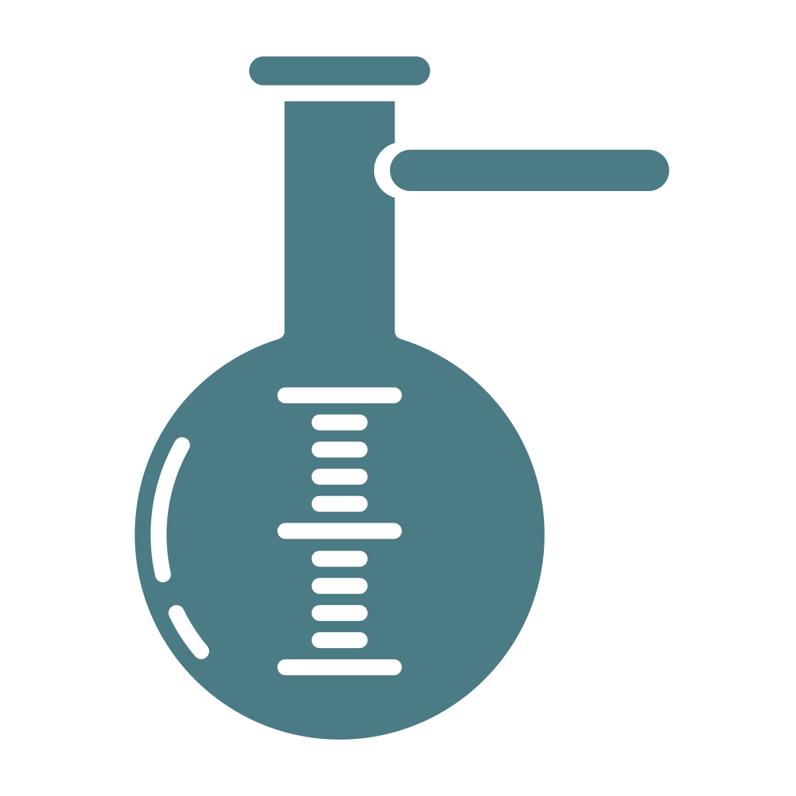
We outline the decision space across three separate modules
Simplified, not exhaustive
Pre-Training
Pre-Training (with original paper approach)
Pre-Training (with adjusted data / approach)
Continual Learning (BERT)
No
Pre-Training
~ 5-7 models
~ 1-2 models
~ 5-7 models
~ 1-2 models
~ 5-7 models
Fine-Tuning
Setup configurations
Datasets (assuming sentiment classification)
multiple tasks, multiple datasets
one task,
multiple datasets
one task, one dataset
SST-2 dataset
IMDb Movie Review dataset
Amazon Product Review dataset
Distillation
TinyBERT
DistillBERT
BERT-Tiny/Mini/Small
~ 5-7 models
~ 1-2 models
~ 5-7 models
~ 1-2 models
~ 5-7 models
~ 1-2 models

Slide 26


Deep-Dive: Pre-Training module
Considered an option
Not considered an option
Pre-Training (with original paper approach)
~ 5-7 models
Pre-Training BERT based on the original approach is computationally very heavy
Per our high-level estimations, BERT pre-training can take up to 800 days based on our current resources (for one model)¹
For this reason, we believe that pre-training BERT based on the original approach is not realistic given the scope of this project
~ 1-2 models
Pre-Training (with adjusted data / architecture)
~ 5-7 models
We can reduce pre-training time by adjusting approach (e.g., reduced sequence length, smaller dataset, smaller architecture) – showed promising results on SST-2
However, we still face risks: (i) still computationally heavy (we need to decrease complexity by factor of 100) and (ii) no distillation possible due to small model size
Pre-training 1-2 models will not have significant impact, due to low model zoo diversity
~ 1-2 models
Continual Learning (BERT)
~ 5-7 models
CL offers most flexibility (e.g., number of epochs, learning rate)
Risk that CL has limited impact on pre-trained BERT (i.e., small weight updates)
No Pre-Training
Using pre-trained base BERT (i) to distill smaller models or (ii) variations in fine-tuning to ensure model diversity
1. Current resources based on one 24 GB V100 GPU. Calculation done in two ways: (1) RoBERTa took 1 day of pre-training with 1024 32 GB V100 GPUs. Adjusting pre-training data scope to original BERT approach and linear adjustment of compute resources leads to ~840 days. (2) The original BERT paper authors used 16 TPU chips for pre-training. Linearly converting to 1 24GB V100 GPU results in ~820 days
Notes:
Estimate regular: 800 days
Cut in half sequence length: 600 days
Use only 20% of data: 120 days
Use smaller architecture like Albert instead of BERT: 60 days
Get 2 GPUs instead of 1: 30 days
Train only 20 epochs instead of 40: 15 days

Slide 27
Deep-Dive: Fine-Tuning module
Considered an option
Not considered an option
Setup configurations
multiple tasks, multiple datasets
Depending on the experiment setup for the pre-training part, we envision two different possibilities:
If we do either pre-training, continual learning or distillation of the BERT model, we opt for simplicity in the fine-tuning module and focus one task (with one dataset), most likely sentiment classification
If we proceed with the already pre-trained version of BERT (no distillation), we will inject diversity in the fine-tuning module by evaluating multiple tasks with different datasets (e.g., sentiment classification, named entity recognition)
one task,
multiple datasets
one task, one dataset
Datasets
(assuming sentiment classification)
SST-2
dataset
Overall, we evaluated 3 datasets: (i) Stanford Sentiment Treebank (SST-2) dataset with ~70k observations, (ii) IMDb Movie dataset with ~50k reviews, and (iii) Amazon Product Review dataset with ~4.2M reviews – all have been used for sentiment classification in other papers
All datasets would be suitable, but we decided to use SST-2 for the following reasons:
Part of the General Language Understanding Evaluation (GLUE) benchmark
Regularly used in research papers, providing a benchmark for consistent comparison
Smaller average (13.3) (vs. other datasets) and max (66) token size
IMDb Movie dataset
Amazon Product Review dataset

Slide 28
Deep-Dive: Distillation module
Considered an option
Not considered an option
TinyBERT
~ 5-7 models
TinyBERT distillation involves a two-stage learning framework – general distillation during pre-training & task-specific distillation during fine-tuning
Performance (for SST-2) is highest (only by a few %-points) when compared with DistillBERT and BERT-small/m
Given
~ 1-2 models
DistillBERT
~ 5-7 models
DistillBERT uses a truncation-based initialization method for the student model, which is pre-trained via distillation from larger teacher model
Time to pre-train a DistillBERT (based on the same BERT data) up to 30 days with our current resources – with adjustments, we can potentially reduce training time
~ 1-2 models
BERT-Tiny/Mini/Small
~ 5-7 models
Pre-Trained Distillation method: (i) pre-training of compact model with unlabeled data, (ii) distillation from teacher with transfer data and (iii) fine-tuning with labeled data
Different variations of BERT model sizes – from 4.4M to 110M parameters
Risk: No information about time required for pre-training
~ 1-2 models

Slide 29
BERT OVERVIEW
Model Details
Data: Wikipedia (2.5B words) + BookCorpus (800M words)
Training Time: 40 epochs (~1M steps)
BERT-Base: 12-layer, 768-hidden, 12-head
Bert introduced two main innovations:
1. Bidirectional Context: Unlike previous models, BERT processes text both ways (left and right), providing a richer understanding of language context and flow.
2. Transformers Architecture:
BERT employs the Transformer architecture, which emphasizes self-attention mechanisms. This architecture enhances the creation of contextualized word representations.
Model Architecture
Multi-headed self attention
Models context
Feed-forward layers
Computes non-linear hierarchical features
Layer norm and residuals
Makes training deep networks healthy
Positional embeddings
Allows model to learn relative positioning
Training Mechanism
Masked LM: 15% of words in a sentence are replaced with a [MASK] token. BERT tries to predict the original word using surrounding context.
f. ex. The man went to the [MASK] to buy a [MASK] of milk.
Next sentence prediction: To learn relationships between sentences, BERT tries to predict whether Sentence B is actual sentence that proceeds Sentence A, or a random sentence.
Downstream tasks: Text classification, question answering, translation etc.
Variations of Bert
BERT-Base: 110M parameters, 12-layer, 768-hidden, 12-heads
BERT-Large: 340M para., 24-layer, 1024-hidden, 16-heads
DistillBert: 66M para., designed for speed by distilling knowledge from BERT
TinyBert: 14.5M para., a smaller version distilled for even more speed

Slide 30
Based on our considerations, we delineate three options from our decision space
Sparsification vs. Distillation?
Option 1
Option 2
Option 3
Option 4
Pre-Training
Pre-Training (with adjusted data / architecture)
Continual Learning
No Pre- Training
No Pre- Training
Fine-Tuning
Fine-Tuning for (i) Sentiment Classification only and on (ii) the Stanford Sentiment Treebank dataset (SST-2)
Fine-Tuning on multiple tasks / different datasets
Distillation
Distillation via BERT-Tiny/Small (done prior to fine-tuning)
Not considered
Not considered
Preferred Option

Slide 31
We evaluated multiple options to determine the best way forward
Pre-training BERT from scratch is expensive compared to continued pre-training
We can generate model diversity more easily in the downstream task which is less expensive
To balance model diversity & resource availability, we will focus on (i) continued pre-training for BERT and (ii) 2 DS tasks while unfreezing all weights
Not exhaustive
1
2
3
4
Model selection
SSL training approach
Weights in TF blocks
DS Tasks (incl. # of datasets)
Total # of models
Comp. Resources
BERT-base
PT from scratch
Unfrozen
Sentiment
~5 models
Very high
1x
5x
1x
…
…
…
…
…
!
…
…
…
Continued PT
Unfrozen
Sentiment
~25 models
Medium
5x
5x
1x
Continued PT
Unfrozen
Q&A
~25 models
Medium
5x
5x
1x
Continued PT
Frozen
Sentiment
~25 models
Medium
5x
5x
1x
Continued PT
Frozen
Q&A
~25 models
Medium
5x
5x
1x
…
…
…
~25 models
Medium
…
…
…
TinyBERT
PT from scratch
Unfrozen
Q&A
~25 models
Very high
1x
5x
1x
…
…
…
~5 models
Very high
…
…
…
1. Xxxx Note: Numbers denote the factor to calculate the number of models

Slide 32
… and derived a variety of options to be evaluated
1
2
3
4
Model selection
SSL training approach
Weights in TF blocks
Downstream task types
Unfreeze TF layers
Sentiment Analysis
PT from scratch
Question Answering
Freeze TF layers
Sentiment Analysis
BERT
Question Answering
Unfreeze TF layers
…
Continued pre-training
…
Freeze TF layers
…
…
…
…
PT from scratch
…
…
…
TinyBERT
…
…
…
PT from scratch
…
…
…
…
…

Slide 33
Summary (?)

Slide 34
Deep-Dive: Evaluation of Options
Appendix

Slide 35
Blueprint Project – A Dataset of Diverse Populations of NN models
However, Transformers introduce an additional layer of intricacy in training (vs. CNNs)
Unlike CNNs, transformers require typically two training phases:
Pre-text task
Downstream task
Given the fundamental changes inherent to how transformers are trained, we need to redefine our approach
TODO: Show here the steps from the blueprint approach / paper + distillation / adversarial attacks

Slide 36

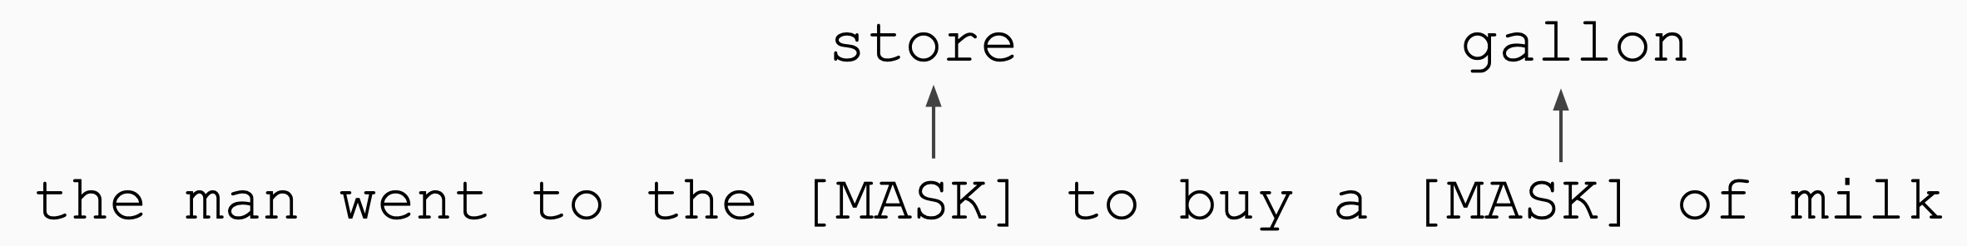

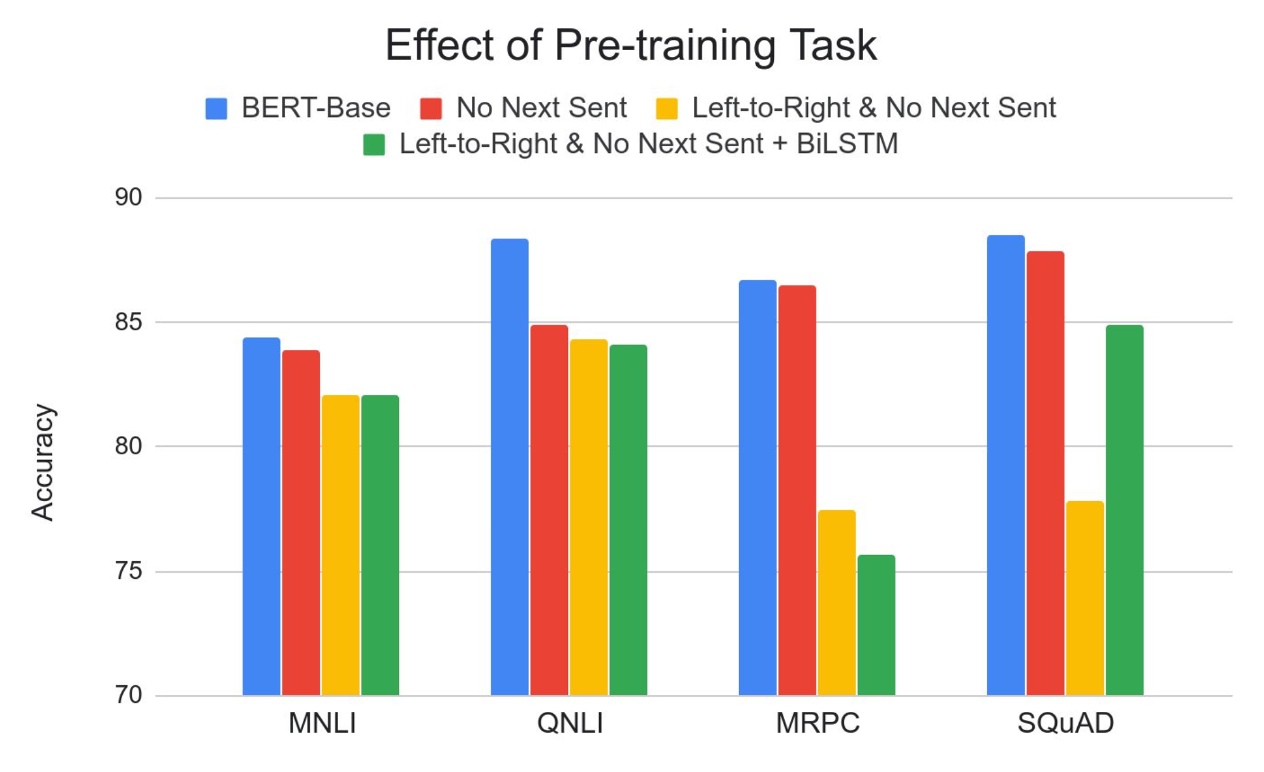
Decoding BERT: Unveiling the Mechanism Behind Deep Bidirectional Language Understanding
Model Details
Data: Wikipedia (2.5B words) + BookCorpus (800M words)
Batch Size: 131,072 words (1024 sequences * 128 length)
Training Time: 1M steps (~40 epochs)
BERT-Base: 12-layer, 768-hidden, 12-head
Training Mechanism
Masked LM: 15% of words in a sentence are replaced with a [MASK] token. BERT tries to predict the original word using surrounding context.
Next sentence prediction: To learn relationships between sentences, BERT tries to predict whether Sentence B is actual sentence that proceeds Sentence A, or a random sentence.
Effect of pretraining
Masked LM is very important for performance on many tasks
Next sentence prediction only makes a significant difference for some tasks like QNLI

Slide 37
Decoding BERT: Unveiling the xxxx
Sven – Suggest to collect tall infos first and then we decide what to keep -> check notes from Damian if something useful
Novelty of Bert
Model Details
Training
Bidirectional Context: Compared to previous models, BERT reads text bidirectionally (considering both the left and the right context in all layers) which gives it a deeper sense of language context and flow
Transformers Architecture: BERT leverages the Transformer architecture, which relies heavily on self-attention mechanisms. This architecture was originally introduced in the paper "Attention is All You Need" by Vaswani et al., and BERT extended its usage for creating contextualized word representations.
Data: Wikipedia (2.5B words) + BookCorpus (800M words)
Batch Size: 1024 sequences * 128 length ~130k words
Training time: 40 epochs To learn relationships between sentences, predict whether Sentence B is actual sentence that proceeds Sentence A, or a random sentence (1M steps)
Optimizer: AdamW, 1e-4 learning rate, linear decay
BERT-Base: 12-layers, 1024-hidden, 16 head, 110M parameters
Masked Language Modelling (MLM): Mask out k% of the input words, and then predict the masked words
Masked LM (compared to left-to-right LM) is very important for performance on most tasks
Next sentence prediction (NSP): 1024 sequences * 128 length ~130k words
Impact on performance of NSP is much smaller than MLM
1. Xxxx

Slide 38
We evaluated multiple options to determine the best configuration going forward
Reword
Pre-training BERT from scratch is expensive compared to continued pre-training
We can generate model diversity more easily in the downstream task which is less expensive
To balance model diversity & resource availability, we will focus on (i) continued pre-training for BERT and (ii) 2 DS tasks while unfreezing all weights
Not exhaustive
1
2
3
4
Model selection
Training approach
Weights in TF blocks
Downstream tasks
Computational Requirements
BERT-base (empty)
PT from scratch
Unfrozen weights
Sentiment
Very high
…
…
…
…
BERT-base (pre-trained)
Continued PT
Unfrozen weights
Sentiment
Medium
Q&A
Frozen weights
Sentiment
Q&A
…
…
…
TinyBERT (empty)
PT from scratch
Unfrozen weights
Q&A
Very high
…
…
…
…
1. Xxxx

